Slide 1
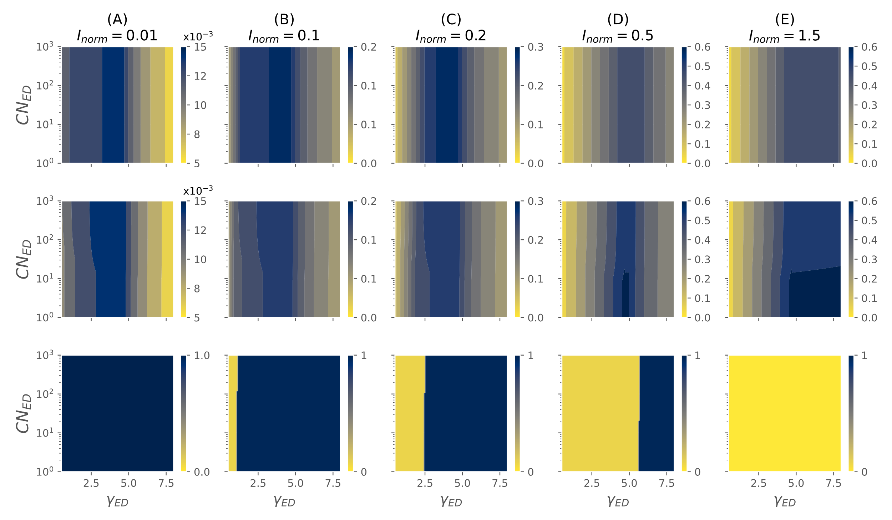
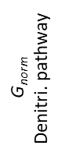
G_{norm}
DNRA pathway
$$\text{G}\text{norm}$$
Denitri. pathway
Max (G_{norm}DNRA–
G_{norm} Denitri)

